Slide 1

Customer Review Classification Using Natural Language Processing
DATA 606 : Capstone in Data Science
Team C Members:
Bhanu Harish Surisetti – IO02971
Jessie Caroline Merugu – UW01251
Sreeja Pendota - XU32613

Slide 2
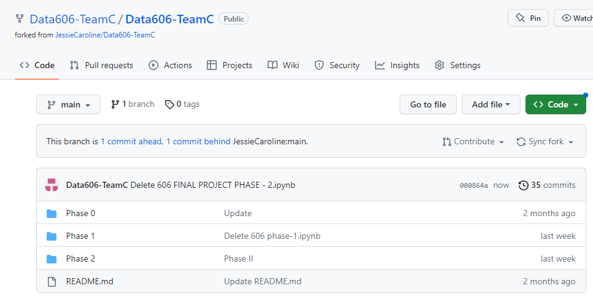
Dataset Source and Kaggle ID
Dataset Source: https://www.kaggle.com/code/duttadebadri/detailed-nlp-project-prediction-visualization/data
Github Page:
https://github.com/Data606-TeamC/Data606-TeamC
Kaggle ID:
Account (User ID 14581160)
Notes:
Notes to presenter:
What is your purpose for sharing this reflection?
Is it at the end of a unit or project?
Are you sharing this reflection, at the attainment of a learning goal you set for yourself?
Is it at the end of a course?
State your purpose for the reflection or even the purpose of the learning experience or learning goal. Be clear and be specific in stating your purpose.

Slide 3
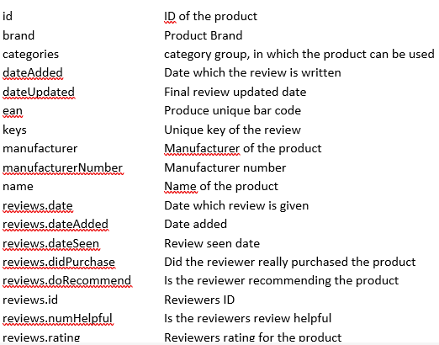
Brief Recap
The objective of the project is to use NLP and machine learning techniques to predict customer satisfaction level (1 – 5 Rating) with products based on their reviews.
In this project we will use NLP and machine learning techniques to predict the fake reviews based on the review text.

Slide 4
The objective of the project is to use various classifiers including Decision Tree Classifier, Random Forest Classifier, K-Nearest Neighbor, and Logistic Regression Classifier. These classifiers will be employed for the purpose of rating classification and distinguishing fake reviews by analyzing the review text using NLP.
Features : Review Text
Target1 : Review Rating
Target2 : Fake review identification
Also considering the below columns as features for further ML:
Numerical Column: Review_useful(count), length of review text
Categorical Column: "category","manufacturer","reviews.didPurchase","reviews.doRecommend","brand","title","name"

Slide 5
Literature Survey
Random forest classifier was previously used to predict customer satisfaction levels, achieving an accuracy of around 70% in classification..
In our current approach, we have split the data into 80% for training and 20% for testing.
To prepare our features for classification, we utilized Text vectorizer to transform text variables and One hot encoder for categorical variables.
Our implementation approach was inspired by the following Kaggle reference: https://www.kaggle.com/code/mdmahmudferdous/nlp-simple-model-for-text-classification.

Slide 6
Literature Survey
The Grammar and Online Product Reviews dataset on Kaggle contains 7,000 reviews across 35 categories and has been used by researchers to explore NLP and machine learning techniques for sentiment analysis and review classification.
One study achieved over 90% accuracy in binary classification of positive and negative reviews using Word2Vec embedding and SVM algorithm.
Another study found that longer reviews and positive sentiment polarity were associated with higher helpfulness scores.
References:
Murgia, A., Bakalli, A., & Fenu, G. (2019). Sentiment Analysis on Online Product Reviews: An Approach Based on Pre-Trained Word Embeddings and Support Vector Machines. In 2019 IEEE International Conference on Smart Computing (SMARTCOMP) (pp. 229-236). IEEE. Wang, X., Li, Y., Li, J., Li, X., & Lu, Y. (2019). How review length and sentiment polarity impact the helpfulness of online reviews: A case study of Amazon product reviews. PloS one, 14(1), e0211346.

Slide 7

What was your process?
Preprocessing the data (cleanup)
Analysis of the Data
01
04
02
03
Comparison of accuracy scores for multiple models
Training the model
Notes:
Notes to presenter:
What did you think at first?
What obstacles did you encounter along the way?
How did you overcome those obstacles?
What images can you add to support your process?
This SmartArt allows you add images and text to help outline your process. If a picture is worth a thousand words, then pictures and words should help you communicate this reflection on learning perfectly! You can always click on Insert>SmartArt to change this graphic or select the graphic and click on the Design contextual menu to change the colors.
Feel free to use more than one slide to reflect upon your process. It also helps to add some video of your process.

Slide 8
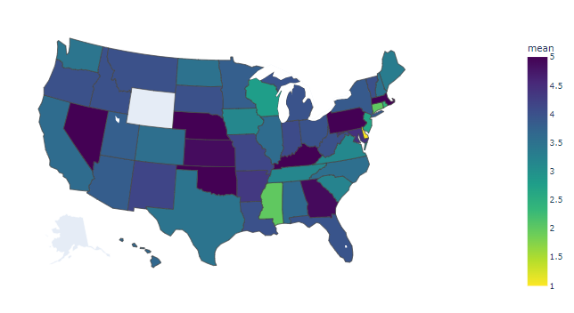
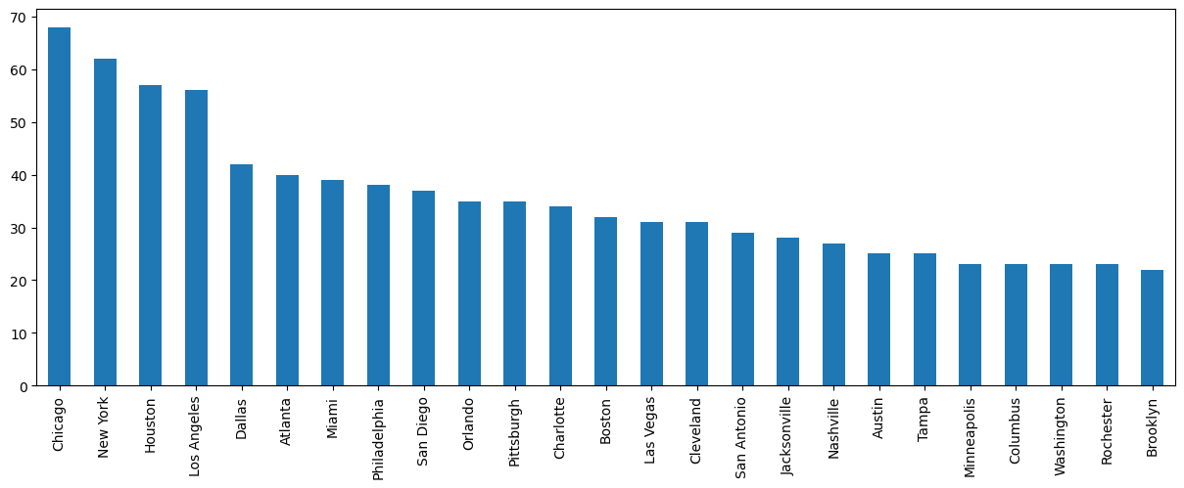
Pre-processing the data

Slide 9
Observations of state wise analysis on the reviews and review rating
Based on the choropleth map, it appears that people from certain states, such as NE, NY, MA, PA, KY, and OK, have given higher average ratings than people from other states.
The data suggests that California residents have provided more ratings compared to residents of other states.
Out of a total of 70,000 records, only 447 include information about the reviewer's state. Therefore, it is difficult to draw conclusions about the impact.
of state on the ratings provided based on this limited sample size.

Slide 10
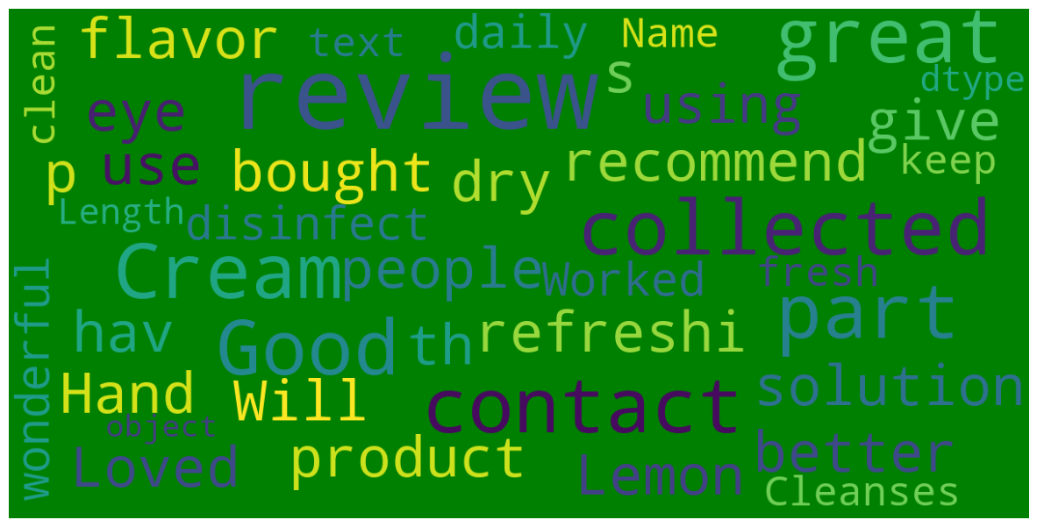
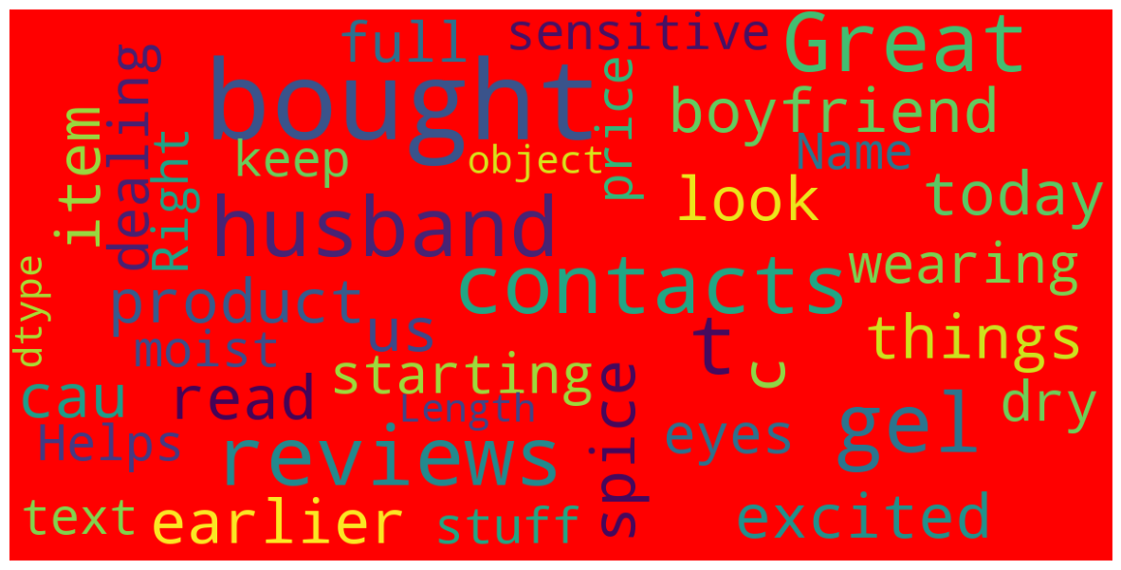
Most used words in reviews

Slide 11
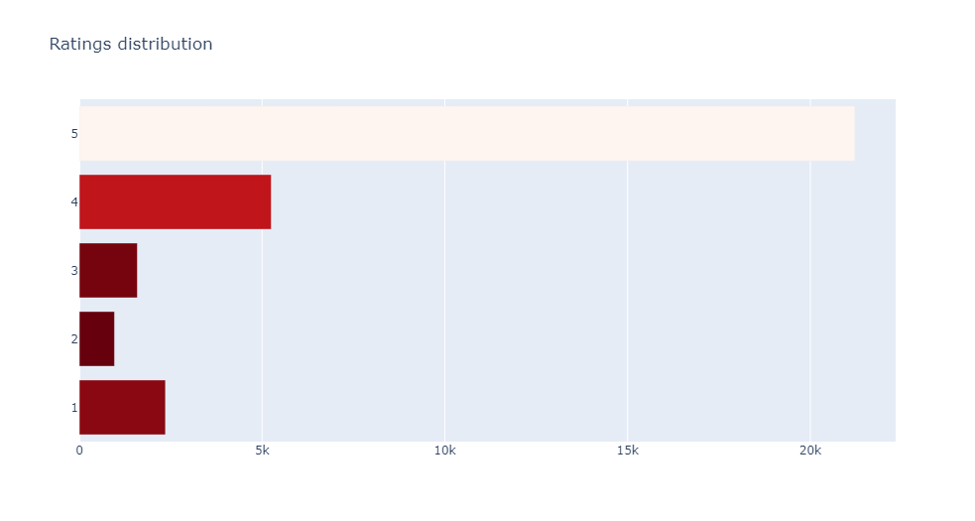
Ratings Distribution
It can be observed that within the range of ratings from 1 to 5,the frequency of reviews is at its lowest point for a rating of 2.
One can note that the frequency of reviews is highest for a rating of 5 within the range of ratings from 1 to 5.

Slide 12
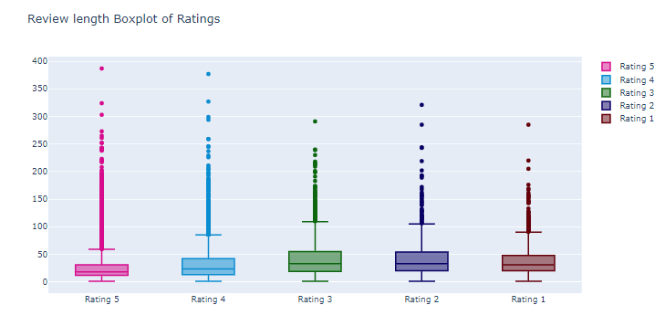
Box plot to visualize the distribution of ratings based on review text length
From the box plots, we can infer that there are outliers in the data for the ratings.
The average words used for the rating 5 is around 18
The average words used for the rating 1 is around 31

Slide 13
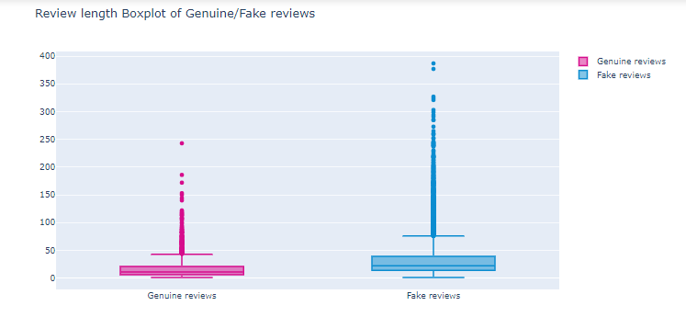
Box plot to visualize the fake and genuine reviews based on review text length
From the box plot we can infer that the maximum words are used for the fake review.
The highest count of words for the fake review is 387
The average number of words used for the fake review is 22.
The average number of words used for the genuine review is around 11 words.

Slide 14
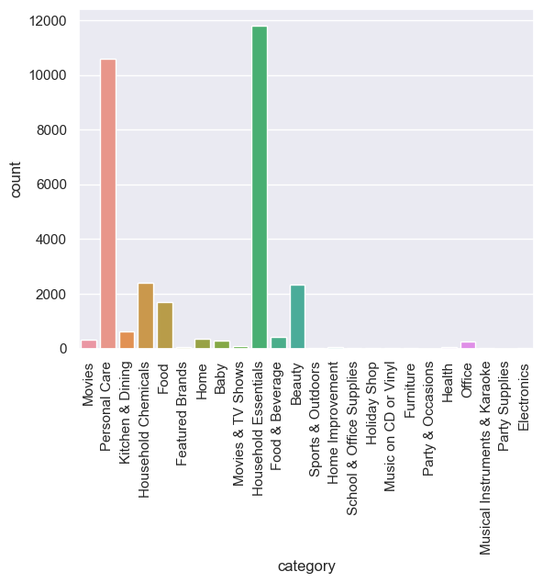
Bar plot to visualize the count of each category
In total, there were 12.48k reviews for household essential products, with 10.593k reviews for personal care products. Additionally, 2330 reviews were submitted for beauty products by customers.

Slide 15
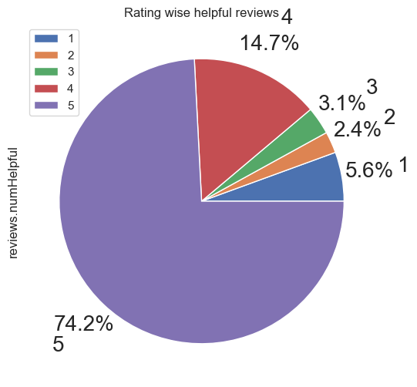
Pie chart to visualize which rating is useful more
From this pie chart it is observed that, people felt 5 rating reviews are more useful than the rest of the others.

Slide 16
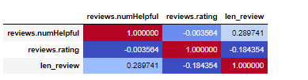
Heatmap to display the Correlation

Slide 17

Decision Tree Classifier
KNN classifier
Logistic Regression Classifier
Accuracy – 59%
Precision – 0.87
F1 Score – 0.81
Accuracy – 66.9%
Precision – 0.86
F1 Score – 0.93
Accuracy – 73%
Precision – 0.86
F1 Score – 0.85
Notes:
Notes to presenter:
What was important about this learning experience?
How is it relevant to your course, yourself, or your society or community?
Why is this significant?
This SmartArt allows you add images and text to help outline your process. If a picture is worth a thousand words, then pictures and words should help you communicate this reflection on learning perfectly! You can always click on Insert>SmartArt to change this graphic or select the graphic and click on the Design contextual menu to change the colors.

Slide 18
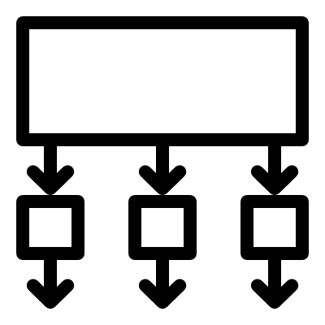
What are your next steps?
Data is imbalanced, handling data imbalance
4
3
Sampling of data – Under sampling, over sampling
2
Classification
1
Notes:
Notes to presenter:
What steps will you be taking as a result of this learning experience?
Did you learn from any failed experiences? How will you do things differently?
What advice will you give to others so they can learn from your experiences?
How can you share what you learned with a real-world audience?
Some examples of next steps might be:
After delivering my first persuasive presentation, I am thinking about joining the debate team.
After making my first film, I’m considering entering it in our school film festival or local film festival.
After connecting with this career expert, I’d like to do some research on that career field because it sounds interesting to me.
This SmartArt allows you add images and text to help outline your process. If a picture is worth a thousand words, then pictures and words should help you communicate this reflection on learning perfectly! You can always click on Insert>SmartArt to change this graphic or select the graphic and click on the Design contextual menu to change the colors.
Feel free to use more than one slide to share your next steps. It also helps to add some video content to explain your message.

Slide 19
Decision Tree Classifier
After Over Sampling
KNN classifier
Logistic Regression Classifier
Accuracy – 93%
Precision – 0.96
F1 Score – 0.97
Accuracy– 80.54%
Precision – 0.99
F1 Score – 0.99
Accuracy – 89%
Precision – 0.96
F1 Score – 0.97
Notes:
Notes to presenter:
What was important about this learning experience?
How is it relevant to your course, yourself, or your society or community?
Why is this significant?
This SmartArt allows you add images and text to help outline your process. If a picture is worth a thousand words, then pictures and words should help you communicate this reflection on learning perfectly! You can always click on Insert>SmartArt to change this graphic or select the graphic and click on the Design contextual menu to change the colors.

Slide 20
Decision Tree Classifer
FAKE AND GENUINE REVIEW CLASSIFICATION
KNN
Logistic Regression
Accuracy– 86.52%
Precision – 0.92
F1 Score – 0.92
Accuracy – 89.8%
Precision – 0.93
F1 Score – 0.93
Accuracy – 91%
Precision – 0.98
F1 Score – 0.95

Slide 21
Next Steps
We have initiated the development of neural networks using LSTM, a powerful variant of recurrent neural networks (RNNs) used for learning long-term dependencies in sequence prediction problems.
In addition to LSTM, we have incorporated other categorical columns for model training, resulting in a low accuracy of approximately 0.10.
We are currently strategizing ways to enhance the accuracy of the model.

Slide 22
THANK YOU

